Slide 1


JAVA
Write once/ run anywhere

Slide 2
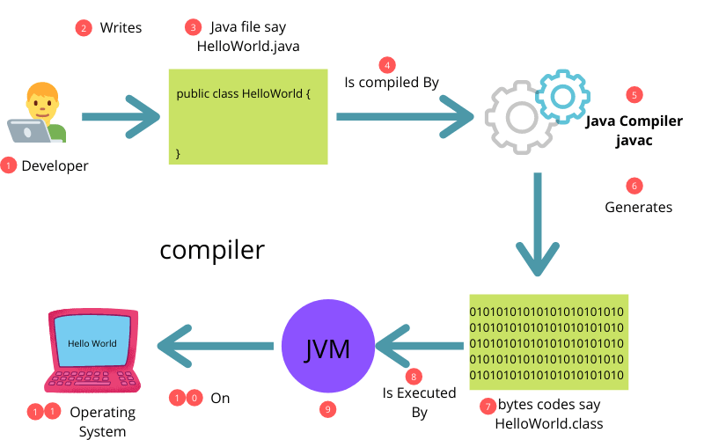

Slide 3
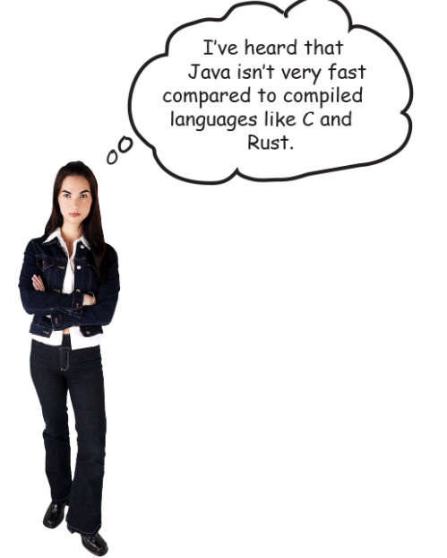
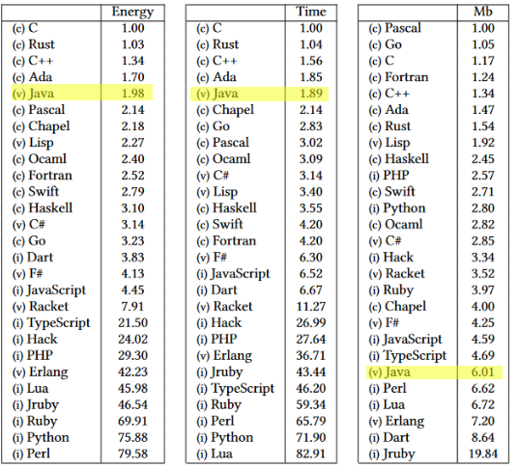
Notes:
Where does c, v and i come from ? Compiled, runs on Virtual machines and interpreted

Slide 4
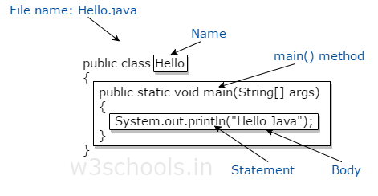
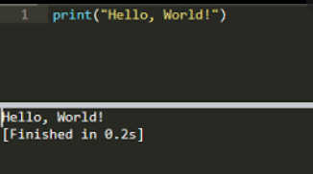

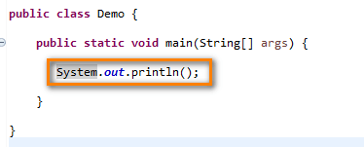
Code structure
Notes:
Most have seen posts like this “ how much it takes to print hello world in languages” While it seems rather complicated to write a simple Hello world in java, we are not going to write only Hello world programs and this counts a lot!
In order to have a start of the application we require a public static void main method so that the compiler can pick where it starts

Slide 5
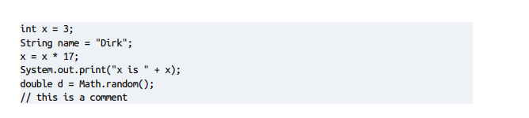

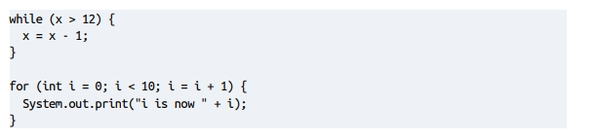
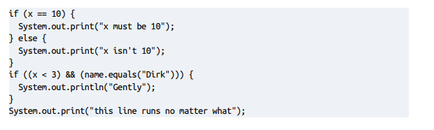
We just start writing code now

Slide 6
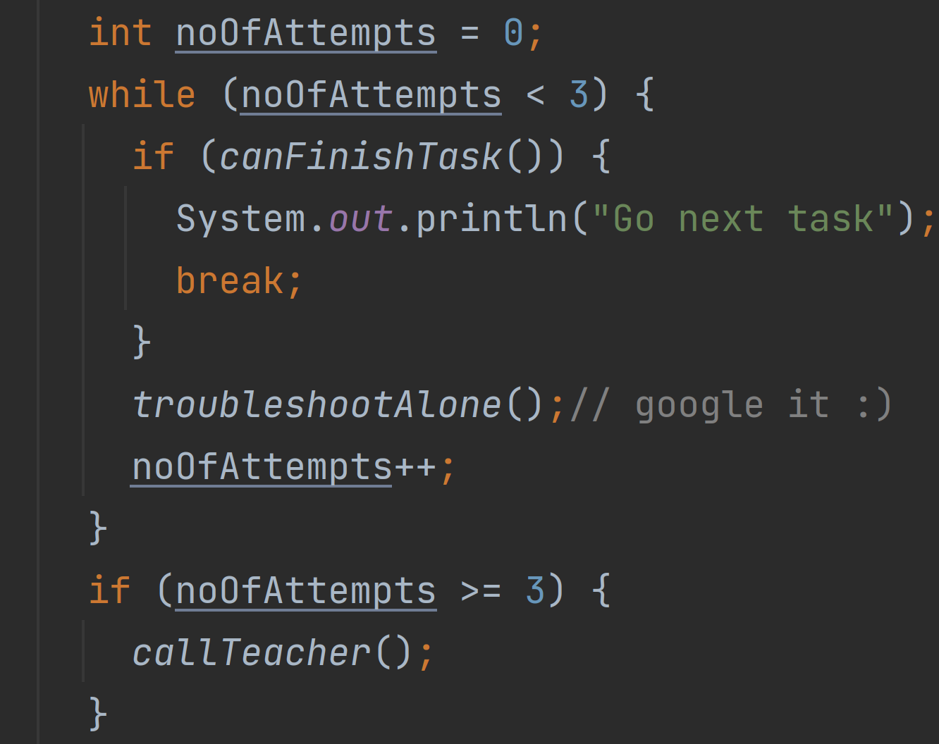

TODO
But first!
Download Intellij community portable edition
Install it on usb or local drive
Start intellij
Navigate to learn on left side menu
Activate learn to program & Get started on it
Start course Java for beginners (from Marketplace)
Complete first 2 chapters

Slide 7
Head First Java
3rd Edition

